Slide 1
Intro to Selenium

Slide 2
What is Selenium?
Free (open source) automated testing
Web applications only
All browsers and platforms
Similar to HP Quick Test Pro (QTP)
UFT - Unified Functional Testing

Slide 3
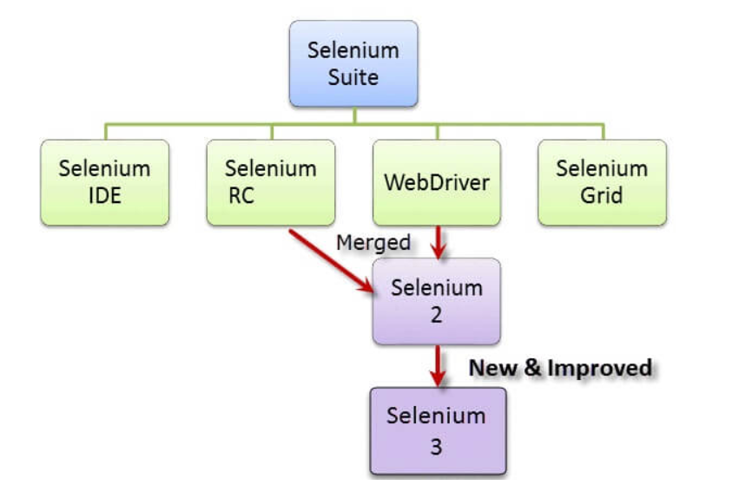
It has four components
Selenium Integrated Development Environment (IDE)
Selenium Remote Control (RC)
WebDriver
Selenium Grid

Slide 4
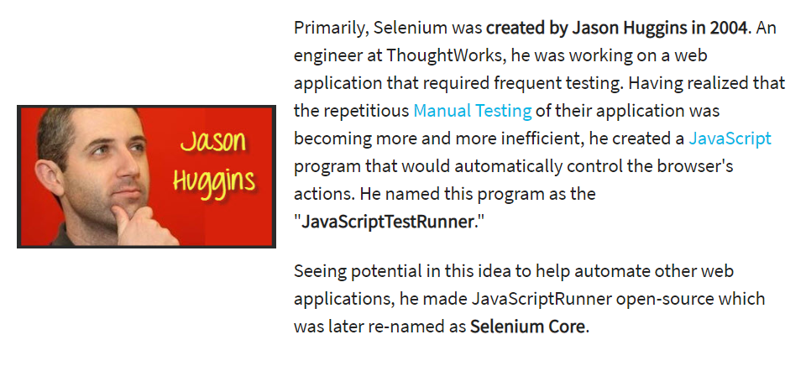
Who developed Selenium?

Slide 9
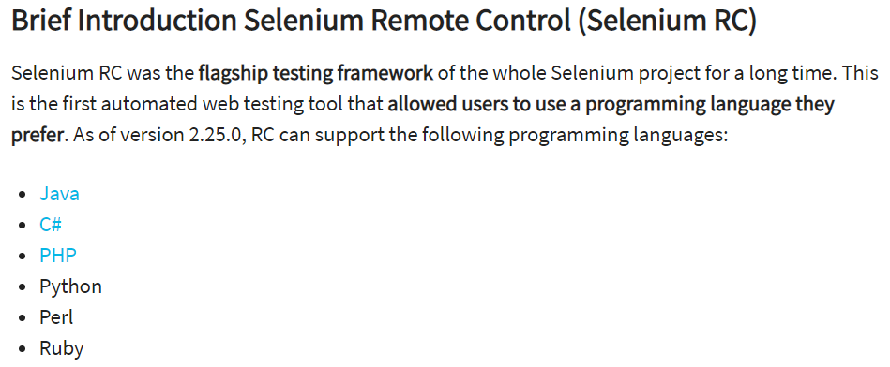
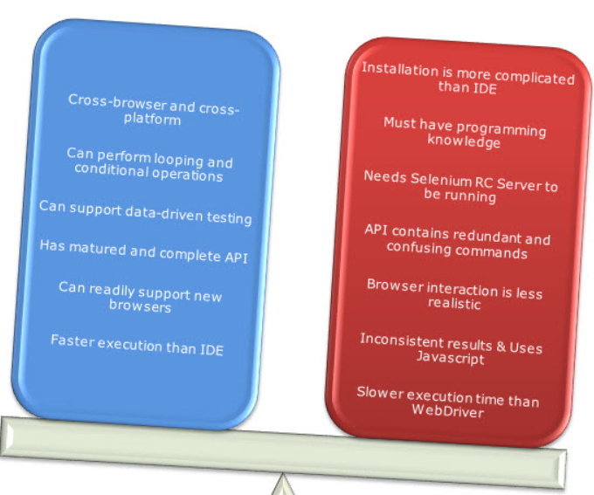

Slide 10
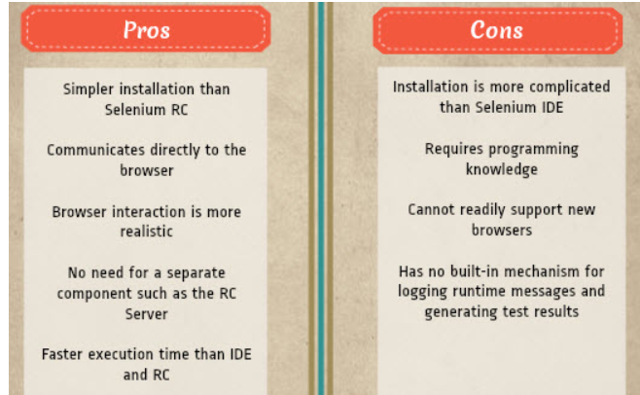

Slide 12
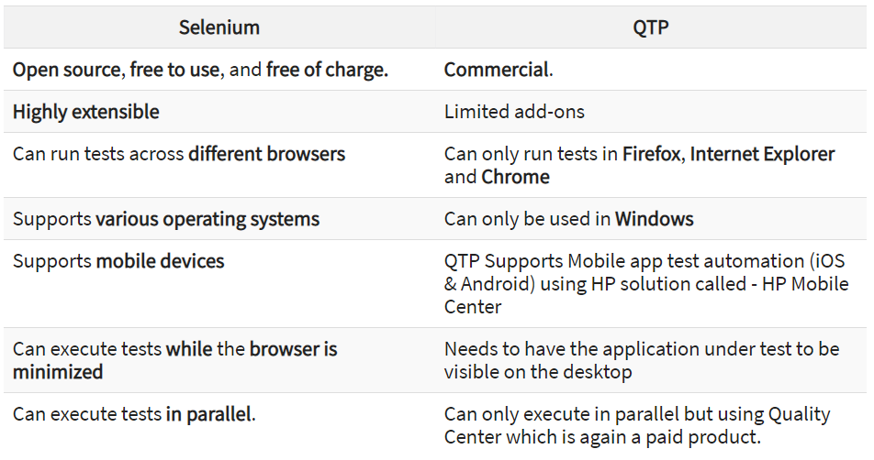

Slide 13
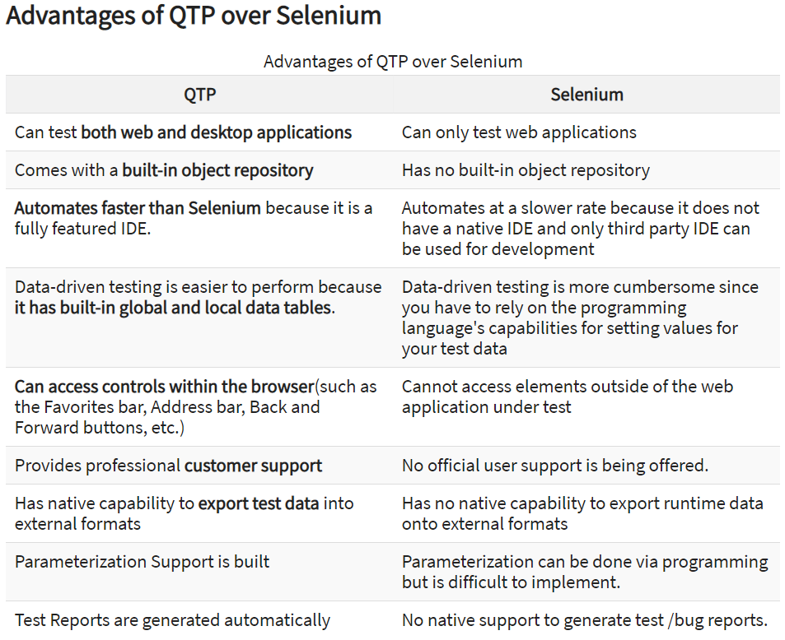

Slide 14
Why Selenium?

