Slide 1
BDD & Gherkin
By Stine Purification

Slide 2
TDD vs. BDD
TDD
BDD
Requirements
Unit Test
Code
Unit tests become the regression tests
Requirements
Specification of Behavior
Code
Functional testing become the regression tests

Slide 3
Why BDD?

Slide 4
BDD
Functional testing is closely tied with the behavior of the application,
User Acceptance Testing (UAT) – is all about behavior the site delivers,
BDD starts with the functionality or behavior of a feature,
Requirements or features are written in the form of Gherkin,
Feature, background, Given, And , When, Then
Standardizes development process across all departments
Tester should not have to test the code directly,
Every bug should be reported in terms of behavior

Slide 5
Gherkin Requirements
How to write requirements or stories?
Feature: As a …. I want ….. So that ….
Background:
Scenario:
Given ….
And …..
When …..
Then …..

Slide 6
Example
How to write requirements or stories?
Feature: Login
As a user I want a login page so that my credentials can be validated before access into my personal account.
Background:
Scenario: Valid user should be able to login to Dashboard
Given a user
And user has valid credentials
When user goes to TechFios site
Then login page should be displayed
When user inputs valid credentials
Then Dashboard page should display
And user credentials should match

Slide 7
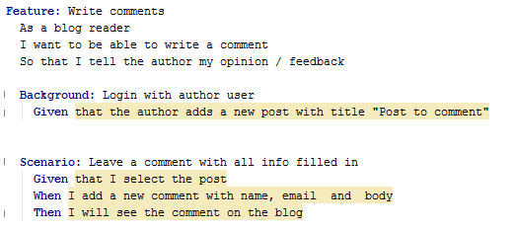
Activity: Write Gherkin
Team up with a partner forming groups of TWO,
Pick a functionality from Techfios Site,
Formulate Gherkin feature and scenario,
Take 10-15 minutes to convert the test case into Gherkin Feature,
Share!
Rubric:

